Slide 1
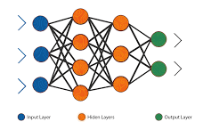
Artificial Neural Networks
What is an Artificial Neural Network?
Architecture of ANN
Neuron Operation
Activation Functions
Loss Functions
Optimizers
ANN Algorithm
Notes:
## Notebook Explanation for ML Practitioners
This notebook provides a practical introduction to fundamental neural network concepts, progressing from simple McCulloch-Pitts neurons to a basic Perceptron and the Delta Rule with a sigmoid activation.
### 1. McCulloch-Pitts Neuron
The initial sections demonstrate the McCulloch-Pitts (MCP) neuron model, the foundational element of artificial neural networks.
- **`mcp_neuron` function**: This function simulates an MCP neuron. It takes inputs, corresponding weights, and a threshold. The core idea is to compute a weighted sum of inputs and compare it against a fixed threshold to produce a binary output (0 or 1).
- **AND, OR, NOT gates**: The notebook shows how to configure the weights and threshold of an MCP neuron to replicate the behavior of basic logic gates (AND, OR, and NOT). This highlights the ability of simple neural models to perform basic logical operations.
### 2. Linear Separability Visualization
This section visualizes the concept of linear separability, which is crucial for understanding the limitations of simple models like the Perceptron.
- **`plot_logic_gate` function**: This function visualizes the input combinations for a given logic gate (AND or XOR) and colors them based on their output (0 or 1).
- **AND vs. XOR plots**: The plots clearly show that the AND gate's inputs can be separated by a single straight line (linearly separable), while the XOR gate's inputs cannot. This visual demonstration explains why a single-layer Perceptron cannot solve the XOR problem.
### 3. Perceptron Learning Rule (AND gate)
This section introduces the Perceptron learning algorithm and demonstrates its application to solve the linearly separable AND gate problem.
- **Perceptron implementation**: The code initializes weights and a bias and iteratively updates them based on the error between the predicted and actual output. The learning rule adjusts weights and bias to minimize this error.
- **Training loop**: The training loop iterates through the dataset, adjusting the weights and bias using the Perceptron update rule. Observe how the weights and bias converge over epochs to values that correctly classify the AND gate inputs.
### 4. Delta Rule using Gradient Descent
This section introduces the Delta Rule, a more general learning rule that uses gradient descent and a differentiable activation function (sigmoid) to train a single-layer network. This allows for learning on non-linearly separable data in principle, although a single layer is still limited.
- **Sigmoid function**: The `sigmoid` function is used as the activation function, squashing the output between 0 and 1.
- **Sigmoid derivative**: The `sigmoid_derivative` is needed for the gradient descent update rule.
- **Delta Rule implementation**: The code initializes weights and iteratively updates them based on the error and the derivative of the activation function. This is a basic form of backpropagation applied to a single layer.
- **XOR problem with Delta Rule**: The notebook attempts to solve the XOR problem using the Delta Rule with a single layer. Notice that the predictions after training are all around 0.5. This demonstrates that a single-layer network, even with a differentiable activation and gradient descent, cannot solve the non-linearly separable XOR problem. This limitation necessitates the use of multi-layer networks (which are not covered in this specific notebook).
This notebook serves as a good starting point to understand the building blocks of neural networks and the evolution of learning algorithms from simple rule-based approaches to gradient-based optimization.

Slide 2
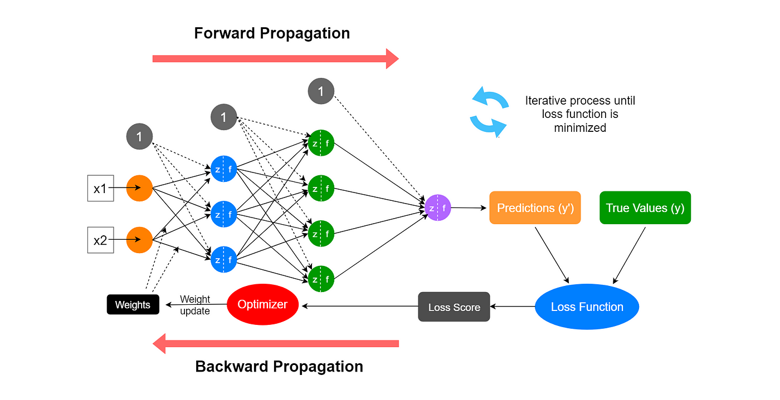
What is an Artificial Neural Network?
Notes:
3-layer example: Input → Hidden → Output
Annotated diagram with nodes, weights, biases

Slide 3
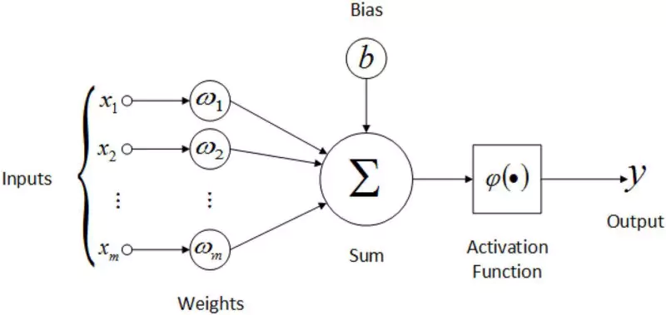
Feedforward Process
Notes:
Data flows left to right (input → output)
At each neuron:
z=∑(wixi)+b,a=activation(z)z = \sum (w_i x_i) + b, \quad a = \text{activation}(z)z=∑(wi​xi​)+b,a=activation(z) Output layer gives final prediction

Slide 4
How a Neuron Works
Notes:
Each neuron does:
Weighted Sum of inputs
Adds bias
Passes result through an activation function
🧠 Formula: z = (w₁·x₁ + w₂·x₂ + ... + wₙ·xₙ) + b a = activation(z)

Slide 5
Activation Functions
Notes:
Each neuron does:
Weighted Sum of inputs
Adds bias
Passes result through an activation function
🧠 Formula: z = (w₁·x₁ + w₂·x₂ + ... + wₙ·xₙ) + b a = activation(z)

Slide 6
Activation Functions
Function | Output Range | Use Case
ReLU | [0, ∞) | Hidden layers
Sigmoid | (0, 1) | Binary classification
Tanh | (-1, 1) | Centered activations
Softmax | [0, 1], sum=1 | Multiclass classification
Notes:
Each neuron does:
Weighted Sum of inputs
Adds bias
Passes result through an activation function
🧠 Formula: z = (w₁·x₁ + w₂·x₂ + ... + wₙ·xₙ) + b a = activation(z)

Slide 7
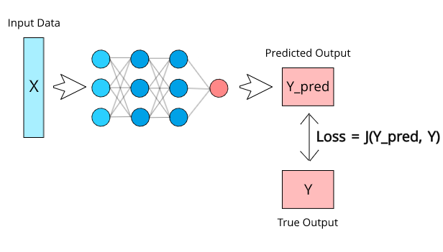
Loss Calculation
Notes:
Compute loss (e.g., Binary Cross-Entropy):
L=−[ylog⁡(y^)+(1−y)log⁡(1−y^)]L = -[y \log(\hat{y}) + (1 - y)\log(1 - \hat{y})]L=−[ylog(y^​)+(1−y)log(1−y^​)]

Slide 8
Loss Calculation
Loss Function | Use Case
Mean Squared Error | Regression
Binary Cross-Entropy | Binary classification
Categorical Cross-Entropy | Multiclass classification
The goal: Minimize loss to improve accuracy
Notes:
Compute loss (e.g., Binary Cross-Entropy):
L=−[ylog⁡(y^)+(1−y)log⁡(1−y^)]L = -[y \log(\hat{y}) + (1 - y)\log(1 - \hat{y})]L=−[ylog(y^​)+(1−y)log(1−y^​)]

Slide 9
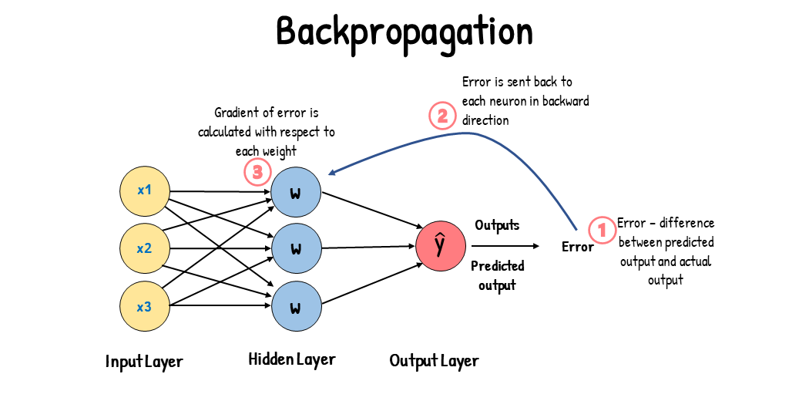
What is Backpropagation?
Notes:
Goal: Adjust weights to minimize loss
Uses chain rule of calculus
Works right to left (output → input)

Slide 10
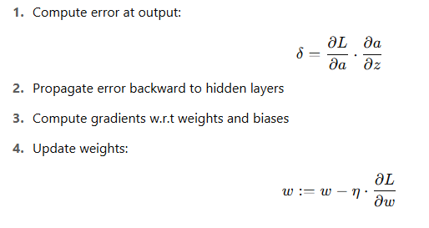
Backpropagation Steps
Notes:
How much did each weight contribute to the error?
“Credit assignment” problem
Use gradients to update weights

Slide 11
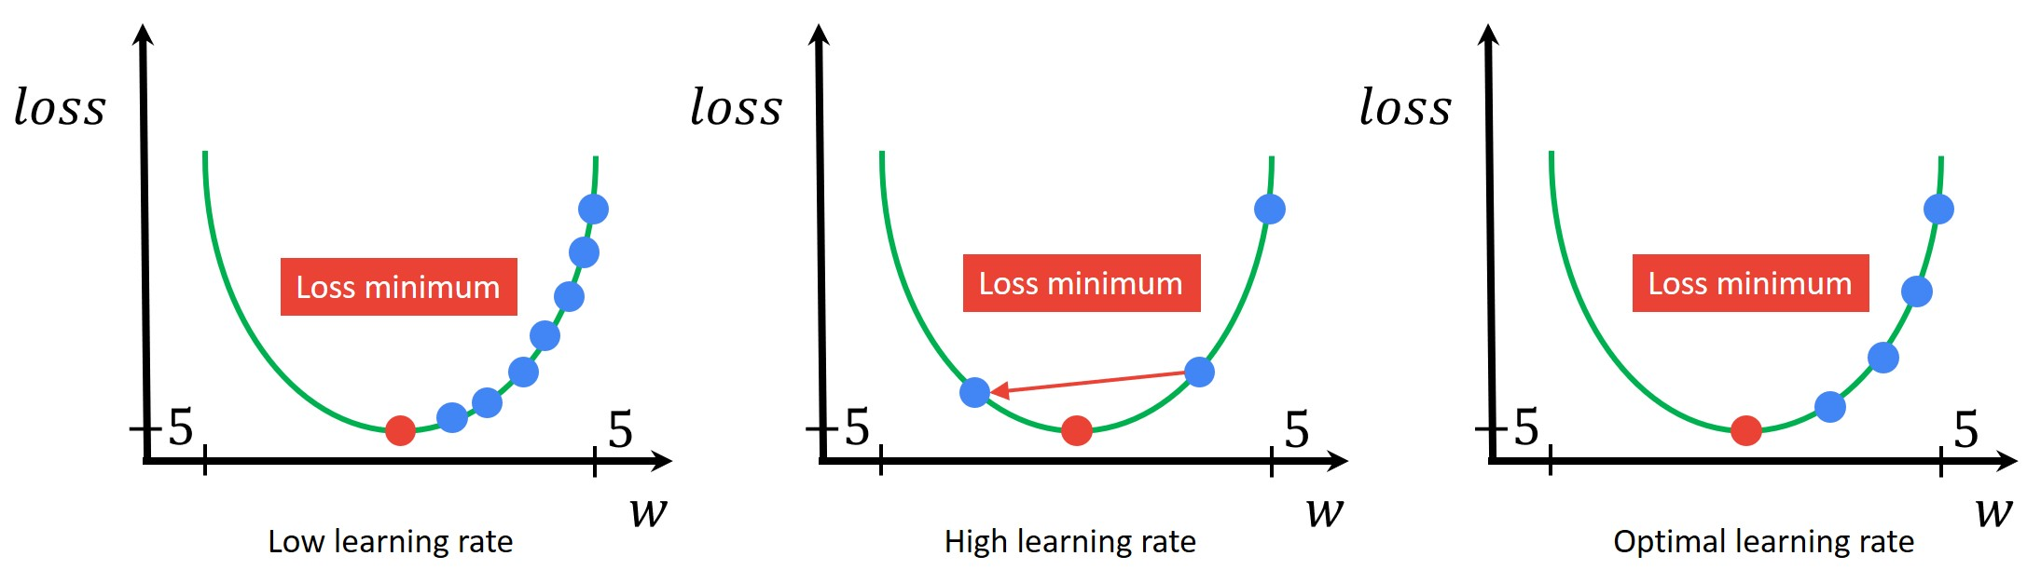
Learning Rate and Convergence
Notes:
Learning rate (η\etaη) controls step size
Too high → diverges
Too low → slow learning

Slide 12
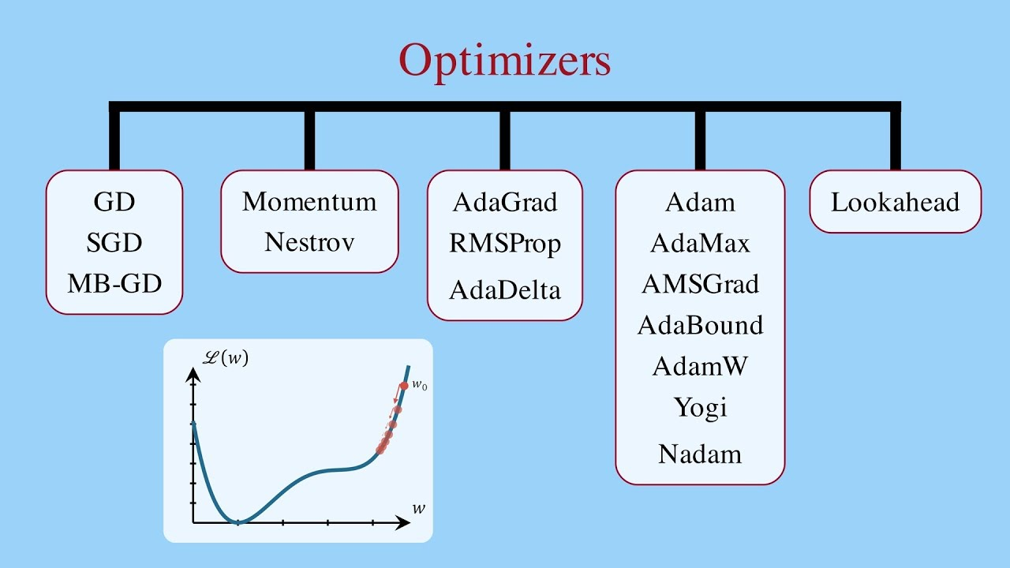
Optimizers
Notes:
Learning rate (η\etaη) controls step size
Too high → diverges
Too low → slow learning

Slide 13
Optimizers
Optimizer | Description | Pros | Cons
SGD (Stochastic Gradient Descent) | Updates weights based on one sample | Simple, works well on convex problems | Slow, gets stuck in local minima
Momentum | Adds past gradients to current update | Faster convergence, reduces oscillation | May overshoot
RMSProp | Uses moving average of squared gradients to normalize | Great for RNNs, handles learning rate | May converge too quickly
Adam (Adaptive Moment Estimation) | Combines Momentum and RMSProp | Fast, adaptive learning rates | May generalize poorly sometimes
Adagrad | Adapts learning rate per parameter | Good for sparse data | Learning rate decays too much
Adadelta | Fixes Adagrad’s decaying rate issue | Adaptive and efficient | Sometimes unstable
Role: Find the best weights and biases to minimize loss
Notes:
Learning rate (η\etaη) controls step size
Too high → diverges
Too low → slow learning

Slide 14
Optimizers
Notes:
Learning rate (η\etaη) controls step size
Too high → diverges
Too low → slow learning

Slide 15
ANN
Technique | Use Case | Output Type | Loss Function | Final Layer Activation
Regression | Predict continuous value | Real Number (float) | Mean Squared Error (MSE) | None
Binary Classification | Classify into two categories | 0 or 1 | Binary Crossentropy | Sigmoid
Multiclass Classification | Classify into 3 or more categories | One-hot encoded classes | Categorical Crossentropy | Softmax
Notes:
Learning rate (η\etaη) controls step size
Too high → diverges
Too low → slow learning

